Slide 1
Tight Analysis of Randomized Rumor Spreading in Complete Graphs
Benjamin Doerr (LIX) joint work with Marvin Künnemann (MPI Informatics)

Slide 2
Randomized Rumor Spreading
Randomized rumor spreading (here: in complete networks)
Start: One vertex knows a rumor
In each round, each vertex knowing the rumor calls a random vertex and forwards a copy of the rumor to it
Question: How long does it take until all vertices know the rumor?
Round 4: Each informed vertex calls a random vertex
Frieze&Grimmett ’85: Θ(log n) rounds suffice with high prob.
Round 3: Each informed vertex calls a random vertex
Round 5: Let‘s hope the remaining two get informed...
Round 2: Each informed vertex calls a random vertex
Round 1: Starting vertex calls random vertex
Round 0: Starting vertex is informed

Slide 3
Why Study Rumor Spreading?
Epidemic algorithm: Quickly and robustly spread information in a network!
Maintaining replicated databases: Name servers in the Xerox corporate internet [Dehmers et al. (1987)]
Communication in unreliable/unknown/dynamic/selfish networks
wireless sensor networks, mobile adhoc networks (robustness)
peer-to-peer sharing of large amounts of data (fairness, scalability)
Model for existing processes
Rumors, computer viruses, diseases, influence processes, …
An early motivation:
Technical tool in a mathematical analysis of an all-pairs shortest path algorithm [Frieze, Grimmett (1985)]

Slide 4
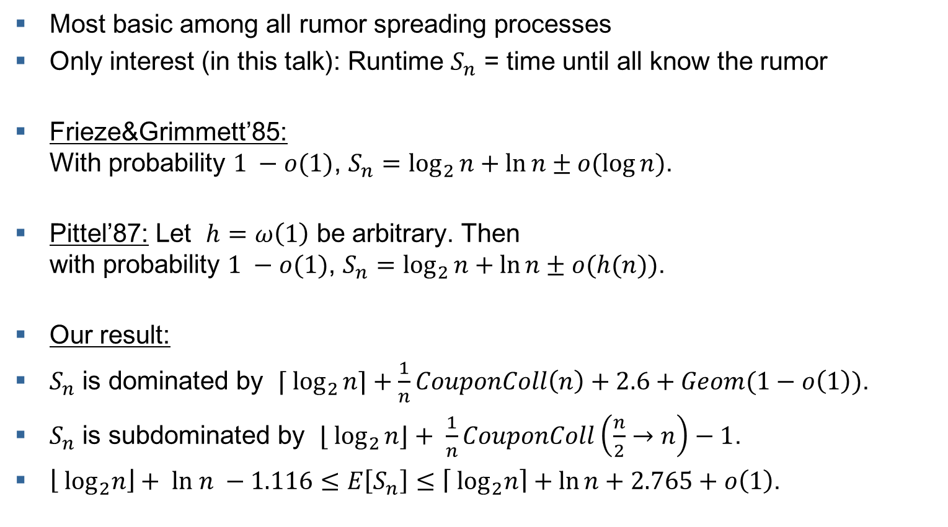
Topic of This Talk: Rumor Spreading in Complete Graphs
Most basic among all rumor spreading processes
Only interest (in this talk): Runtime $S_{n}$ = time until all know the rumor
Frieze&Grimmett’85: With probability $1 −o(1)$, $S_{n}=\log_{2}{n}+\ln{n}±o(\log{n})$.
Pittel’87: Let $h=ω\left(1\right)$ be arbitrary. Then with probability $1 −o(1)$, $S_{n}=\log_{2}{n}+\ln{n}±o(h(n))$.
Our result:
$S_{n}$ is dominated by $⌈ \log_{2}{n}⌉+\frac{1}{n}CouponColl\left(n\right)+2.6+Geom(1−o\left(1\right))$.
$S_{n}$ is subdominated by ${⌊ log}_{2}{n}⌋+ \frac{1}{n}CouponColl\left(\frac{n}{2}→n\right)−1$.
$\left\lfloor \log_{2}n\right\rfloor + ln n −1.116≤E\left[S_{n}\right]≤\left\lceil \log_{2}n\right\rceil +\ln{n}+2.765+o\left(1\right)$.

Slide 5

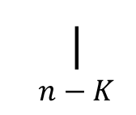

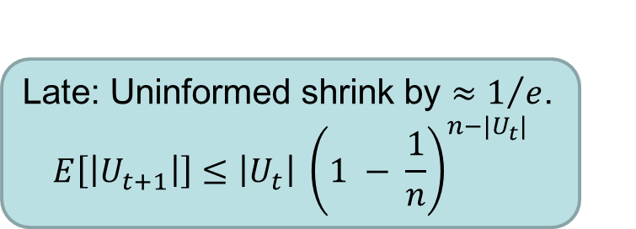
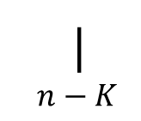










What is the Difficulty?
Two different “regimes”:
Early: Informed nodes double. $$E\left[\left|I_{t+1}\right|\right]≥2 \left|I_{t}\right| \left(1 − \frac{3\left|I_{t}\right|}{4n}\right)$$
Late: Uninformed shrink by $≈1/e$. $$E\left[\left|U_{t+1}\right|\right]≤\left|U_{t}\right| {\left(1 − \frac{1}{n}\right)}^{n−|U_{t}|}$$
Frieze&Grimmett’85: 5 phases (7 pages proof)
| 1
| $K$
| $εn$
| $(1−ε)n$
| $n−K$
| $n$
$t:$ $\left|I_{t}\right|:$
Pittel’87: 7 phases (9 pages proof)
| 1
| ${\left(\frac{n}{\log{n}}\right)}^{1/2}$
| $\frac{n}{\log^{2}{n}}$
| $εn$
| $(1−ε)n$
| $n−n^{2/3}\log^{2}{n}$
| $n−K$
| $n$
$t:$ $\left|I_{t}\right|:$
Our result: 2 phases (5 pages proof)
| 1
| $≈n/4$
| $n$
$t:$ $\left|I_{t}\right|:$

Slide 6
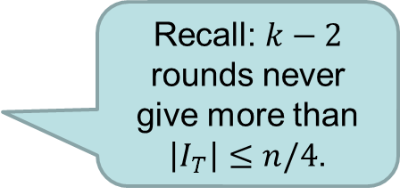
The Early Regime
Early regime: $E\left[\left|I_{t+1}\right|\right]≥2 \left|I_{t}\right| \left(1 − \frac{3\left|I_{t}\right|}{4n}\right)$
Chernoff bound: $\left|I_{t+1}\right|≥2 \left|I_{t}\right| \left(1 − \frac{3\left|I_{t}\right|}{4n}−n^{−ε/2}\right)$ with prob. $1−O(n^{−1+ε})$.
Using $\left|I_{t}\right|≤2^{t}$ (ideal world): $\left|I_{t+1}\right|≥2 \left|I_{t}\right| \left(1 −\frac{3}{4}\frac{2^{t}}{n}−n^{−ε/2}\right)$
Then $\left|I_{T}\right|≥2^{T}\prod_{t=0}^{T−1}{\left(1−\frac{3}{4}\frac{2^{t}}{n}−n^{−ε/2}\right)}$ [induction]
$≥2^{T}\left(1−\sum_{t=0}^{T−1}{\left(\frac{3}{4}\frac{2^{t}}{n}+n^{−ε/2}\right)} \right)$ [Bernoulli’s inequality]
$≥2^{T}\left(1−\frac{3}{4}\frac{2^{T}}{n}−Tn^{−ε/2}\right)$, still with probability $1−O(n^{−1+ε})$
For $n=2^{k}$: $\left|I_{T}\right|≥\frac{5n}{16}−o(n)$ after $T=k−1$ rounds.
Recall: $k−2$ rounds never give more than $\left|I_{T}\right|≤n/4$.

Slide 7
The Late Regime
Late regime:$E\left[\left|U_{t+1}\right|\right]≤\left|U_{t}\right| {\left(1 − \frac{1}{n}\right)}^{n−|U_{t}|}$
If $\left|U_{t}\right|=cn$, then $E[|U_{t+1}|]≈\left|U_{t}\right|e^{−1+c}$. (1)
Shrinking factor not constant → difficult ☹
Solution: Detour via coupon collector!
(1) and induction and Chernoff: $\left|U_{t+i}\right|≤\left|U_{t}\right|{\left(e^{−1+c+ε}\right)}^{i}$ very likely. [note: too weak to give a good run-time directly]
Total number of random calls in rounds $t+1…t+l$:
$\sum_{i=1}^{l}{|I_{t+i}|}=\sum_{i=1}^{l}{(n−\left|U_{t+i}\right|)}≥ln−\left|U_{t}\right|\sum_{i=1}^{l}{{\left(e^{−1+c+ε}\right)}^{i}}=ln −O(n)$
[note: the $c$ and the $ε$ don’t matter a lot]
If this number is larger than $CouponColl((1−c)n→n)$, then all nodes are informed [so $l=\ln\left(n\right)+Θ\left(1\right)$ does the job].
Our constant follow from $c=5/16$ and $ε=o\left(1\right).$

Slide 8
Optimizing the Additive Constant
Proof on last 2 slides reveals:
We do “perfect” work apart from the middle range where both $\left|I_{t}\right|$ and $\left|U_{t}\right|$ are $Θ(n)$.
The biggest inaccuracies are caused by a handful of iterations before and after $\left|I_{t}\right|=\frac{5}{16}n$.
→ Doing these by hand easily gives better bound ☺
Karl Bringmann (MPI Informatics) did this numerically. Result:
$E[S_{n}]=\log_{2}{n}+\ln{n}+0.68252763$…
what is hidden in the …, is not a constant, but a function of $n$ taking values in some interval of length less than ${10}^{−10}$.
Merci pour votre attention ☺

